Slide 1
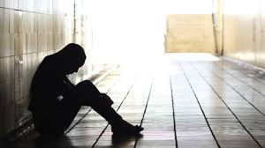

Battle exhaustion and the Life of Faith with God and God Alone
Genesis 15: 1-21

Slide 2
1st message In May 2016 - Journey of faith.
We discovered that a life of faith starts with a step of faith following God's direction for your life.
2nd message in Nov 2016 - How to avoid making bad decision
Next we see that the life of faith has its famine.
3rd message in Dec 2016 - Walking by Faith
The Life of Faith also has its own family dispute
4th Message in Feb2017 - Victory comes through faith
Then we discovered that there are times where we have to use force against the enemy to take back what he has stolen from us.
5th message in march 2017 - Battle Exhaustion And The Life Of Faith Fear Not Part 1 Fear not because the gospel message to us is Jesus Christ in you the Hope of Glory.

Slide 3
Remember when you are on cross roads, we need a word from God to reassure us of three important things in our life.
Reassurance About God's Presence
Reassurance About God's Promise
Reassurance About God's Purpose

Slide 4

I. Reassurance Of God's Presence: Genesis 15:1
A. God's Presence Assures Me of My Safety.
“I Am Thy Shield.”
Psalms 3:1
Psalm 5:12
B. God's Presence Assures Me Of My Reward:
Abraham I AM thy exceeding great reward.
Gen14:21-23

Slide 5
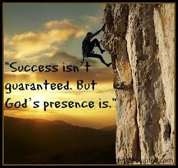
II. Reassurance About God's Promise: Genesis 15:2-6
Ask God About It:
Listen To God.
Look To God:
Look inward ,you will be disappointed.
Look down, you will be discouraged.
Look around, you will be worried.
but Look Up , you will be encouraged.
Believe God:
When we face unfulfilled promises only God and God Alone can reassure us of His Promises.

Slide 6
III. Reassurance Of God's Purpose: Verse 7-18
A. He Reminded Abraham Where He Had Brought Him From and Why He had Brought Him Out. V 7b
B. He Informed Abraham of Future Events: V 13
look at the time we are living in. It's a:
Time of Deception: Matthew 24:24-25
Time of Degradation: Luke 17:26-29
Time Of Demonic Activity : 1 Peter 5:8
C. He Entered Into A Covenant Relationship With Abraham. Genesis 15:9-10 & 18
Hebrews 6:13

