Slide 1
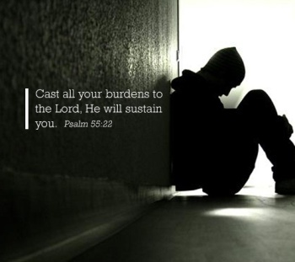
Why Carry Your Burden?

Slide 2
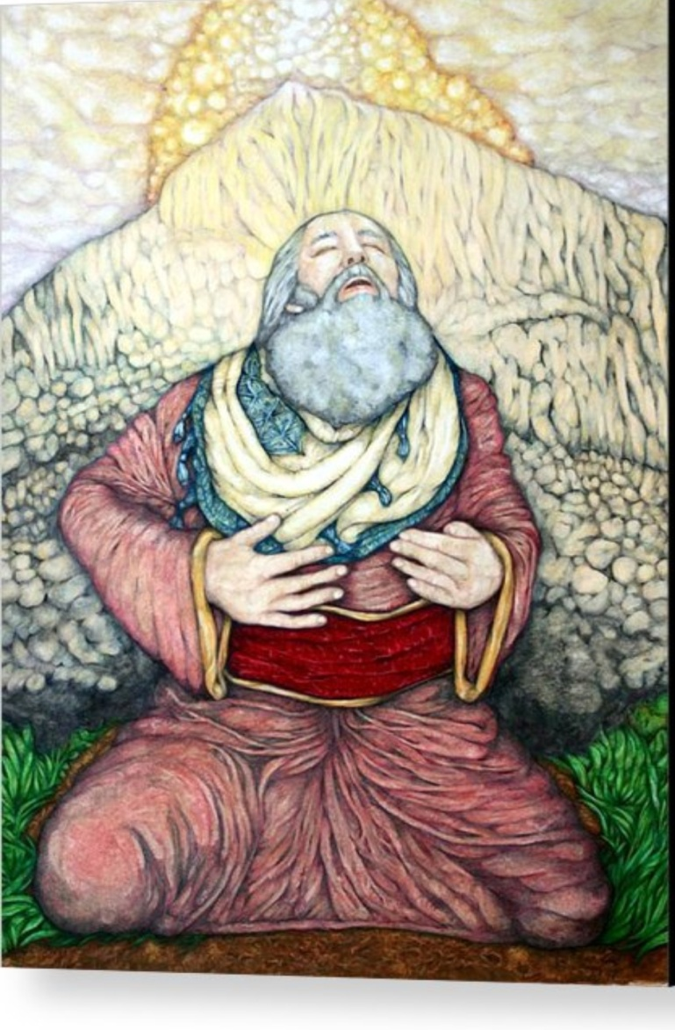
What is a God-given burden?
How to respond to God-given burden.
Num 11:11 “And Moses said to the LORD, "Why are you treating me, your servant, so miserably? What did I do to deserve the burden of a people like this?
Num11:14;
Num 11:17

Slide 3
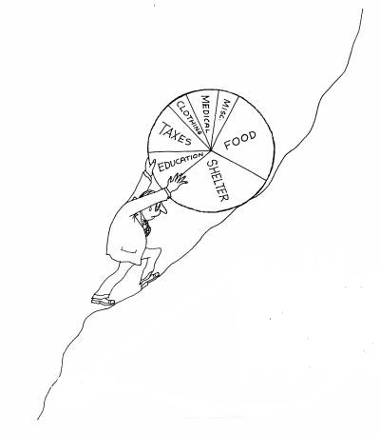
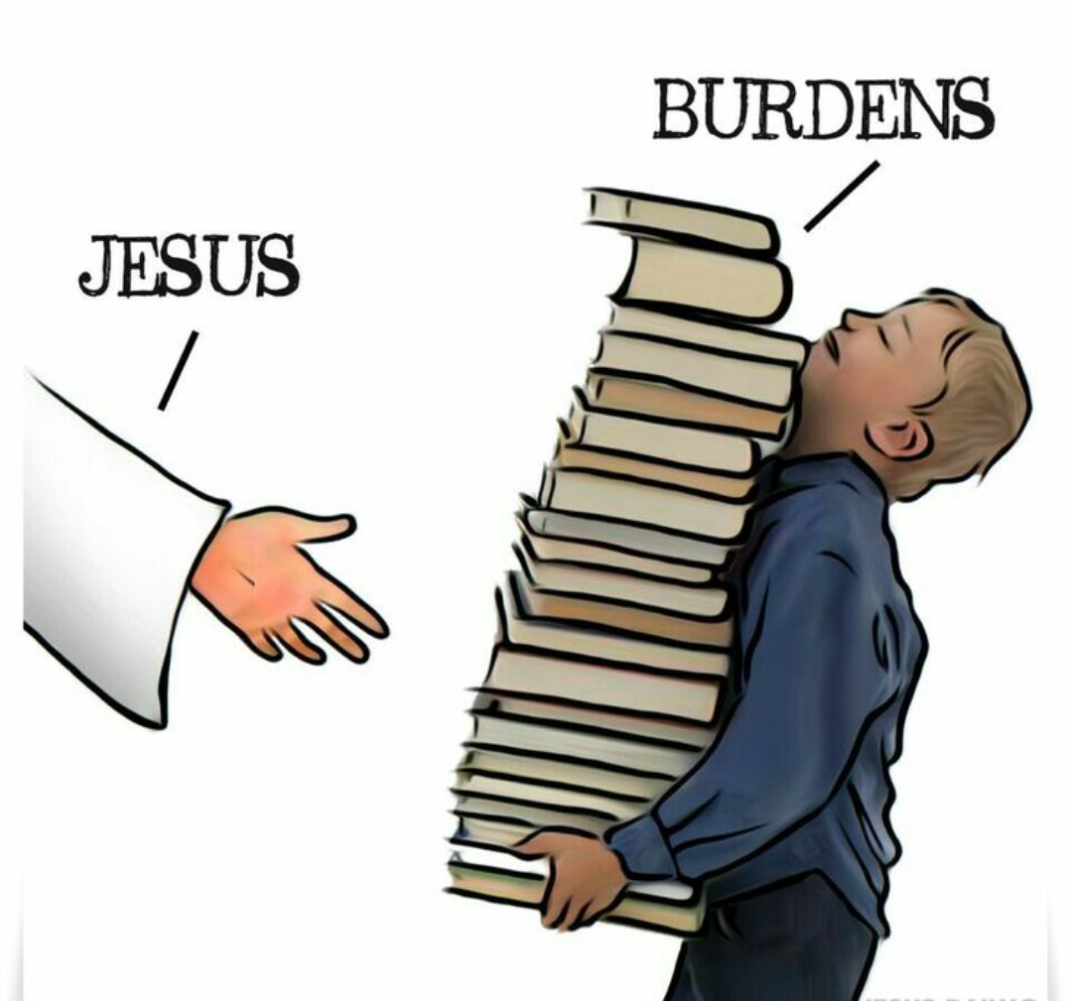
Different kinds of burdens. Ps 38:4

Slide 4
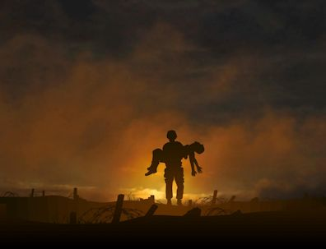
How do I respond to those other kinds of burdens?
Matthew 11:28–30
Only Jesus can deals with our burden.
“And if He carried the weight of the world upon His shoulders
I know my brother that He will carry you
And if He carried the weight of the world upon His shoulders
I know my sister that He will carry you
He said, "Come unto Me all who are weary, and I will give you rest"

Slide 5
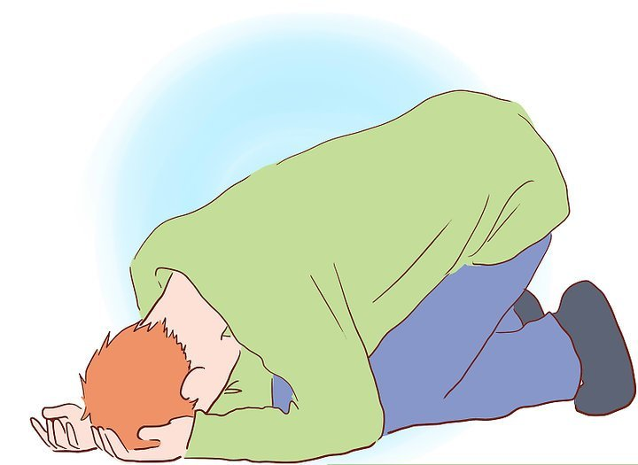
He is motivated by love
1Jn 2:1, Psalm 55:22
“Cast thy burdens upon the Lord And He shall sustain thee
He shall never suffer the righteous to be moved
As for me, I will call upon God And the Lord will save me Evening and morning and at noon will I pray, And cry aloud
He shall hear my voice.”
Come to Him and surrender. Psalm 68:19
“I surrender all,
I surrender all,
All to Thee my blessed Saviour,
I surrender all.”

Slide 6
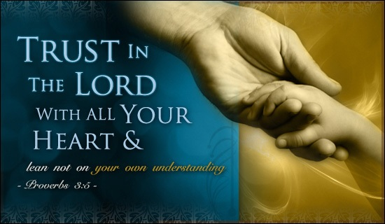
Trust Him.
1 Peter 5:7, Proverbs 3:5–6

