Slide 1
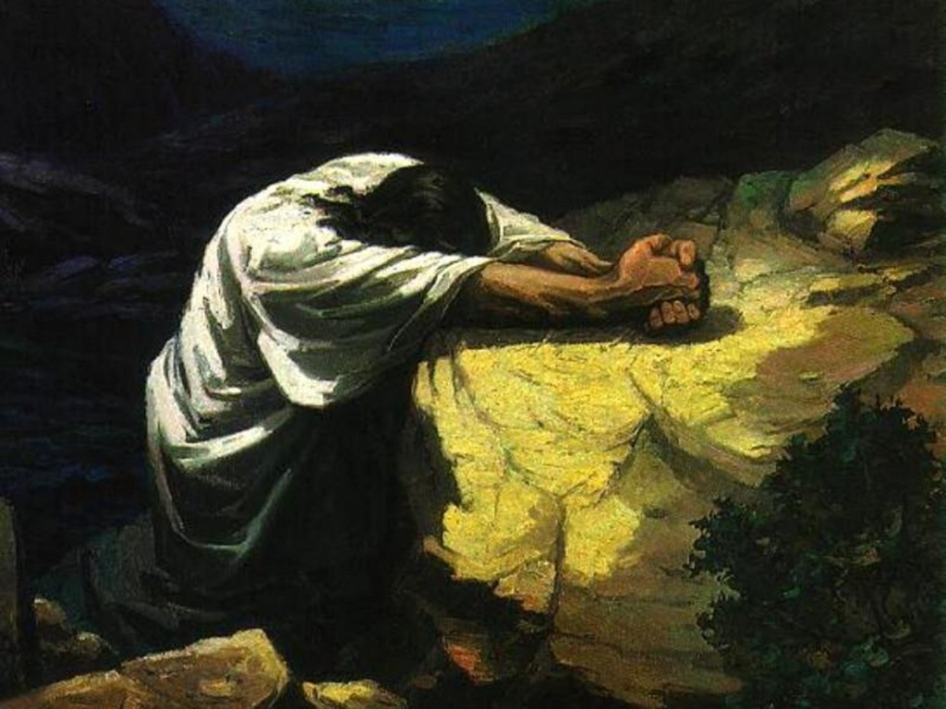
Watch and Pray Matt 26:36-46

Slide 2
OUTSIDE (JUDAS)
OUTER COURT (The 8 disciples)
(INNER COURT) Peter, James John
Holy of Holies (JESUS)

Slide 3
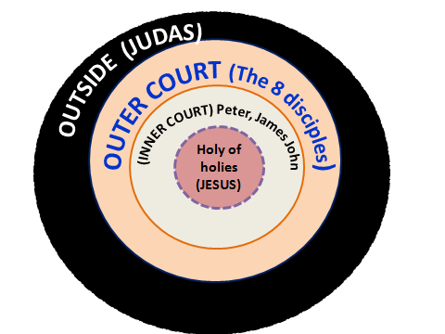
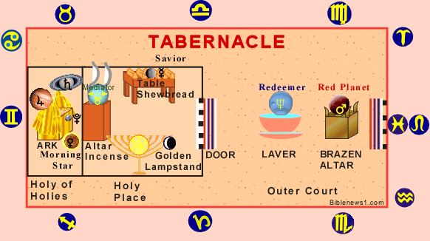

Slide 4
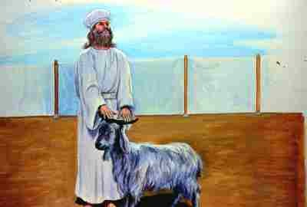
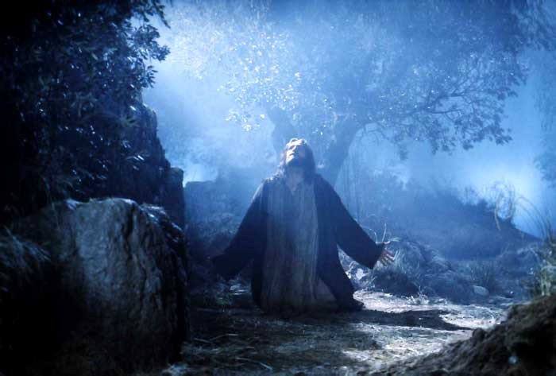
Lev 16:21-22 1 Pet 2:24

Slide 5
Never assume that we are spiritual just because there are spiritual people around us in the church.
Let us pray our inner devotion to God be always greater than that which is visible outwardly.
Let us pray and ask God to give us the grace to Watch and pray at all times.
This will preserve our individual lives, our families, and our church, so that Jesus will be glorified in all!

Slide 6
Let us come to the Lord in prayer asking Him to strengthen us every time, when we pray, that we will all be able to enter into the Holy of Holies.
The spirit of slumber that worked in the garden of Gethsemane,works in many churches even today. The tragedy is when demons put many people to sleep in the body of Christ.
Psa. 23.2 He maketh me to lie down in green pastures: he leadeth me beside the still waters.
Let us decree peace into the land of Oman.
Keep Oman as a point of contact and lift up 3 other nations
Let us pray against future any riots and war in Oman.

Slide 7
7. 1Tim. 2.1-4 “I urge, then, first of all, that requests, prayers, intercession and thanksgiving be made for everyone—2 for kings and all those in authority, that we may live peaceful and quiet lives in all godliness and holiness, 3 This is good, and pleases God our Savior,4 who wants all men to be saved and to come to a knowledge of the truth
Pray for His Majesty’s good health, long life.
Pray that all his ministers will give good council to the King.
Pray that they will fear and honor the King
Pray that all the laws passed by them will be good for the people and benefit the church of Christ in the land.

Slide 8
Pray that we will continue to have the freedom to practice our faith in this land.
Pray for the salvation of the people of this land.
Pray for the people of this land, for God to prosper them and not to harm them.
Pray against any natural disasters in Oman. Psa. 91.3 Surely he will save you from the fowler's snare and from the deadly pestilence
Let us pray against road accidents, air accidents and ship wrecks in this land.
Let us ask God to protect His children from sudden death. Psa. 91.7-8 A thousand may fall at your side, ten thousand at your right hand, but it will not come near you. 8 You will only observe with your eyes and see the punishment of the wicked

Slide 9
8. Pray for tomorrow service
For God’s presence to manifest in this place
For the choir
Friday school children and teachers
Ushers
New comers, every back slider to turn back to God
Coordinator
Messenger of God’s word

Slide 11
OUTSIDE (JUDAS)
OUTER COURT (The 8 disciples)
(INNER COURT) Peter, James John
Holy of holies (JESUS)

