Slide 1
The Journey of Faith Part 2
How To Avoid Making A Bad Decision
Don't Run From The Problem
Be Thoughtful Your Decisions Can Effected Others
He Stop Trusting God and Start Scheming
He Moved From Having Faith in God's Protection to Fearing Man
He Became Self Centered
He Became a Curse Instead of a Blessing
Correct Your Decision and Change Your Direction
He Returned to Bethel
He Returned To Worship
He Returned to Prayer

Slide 2
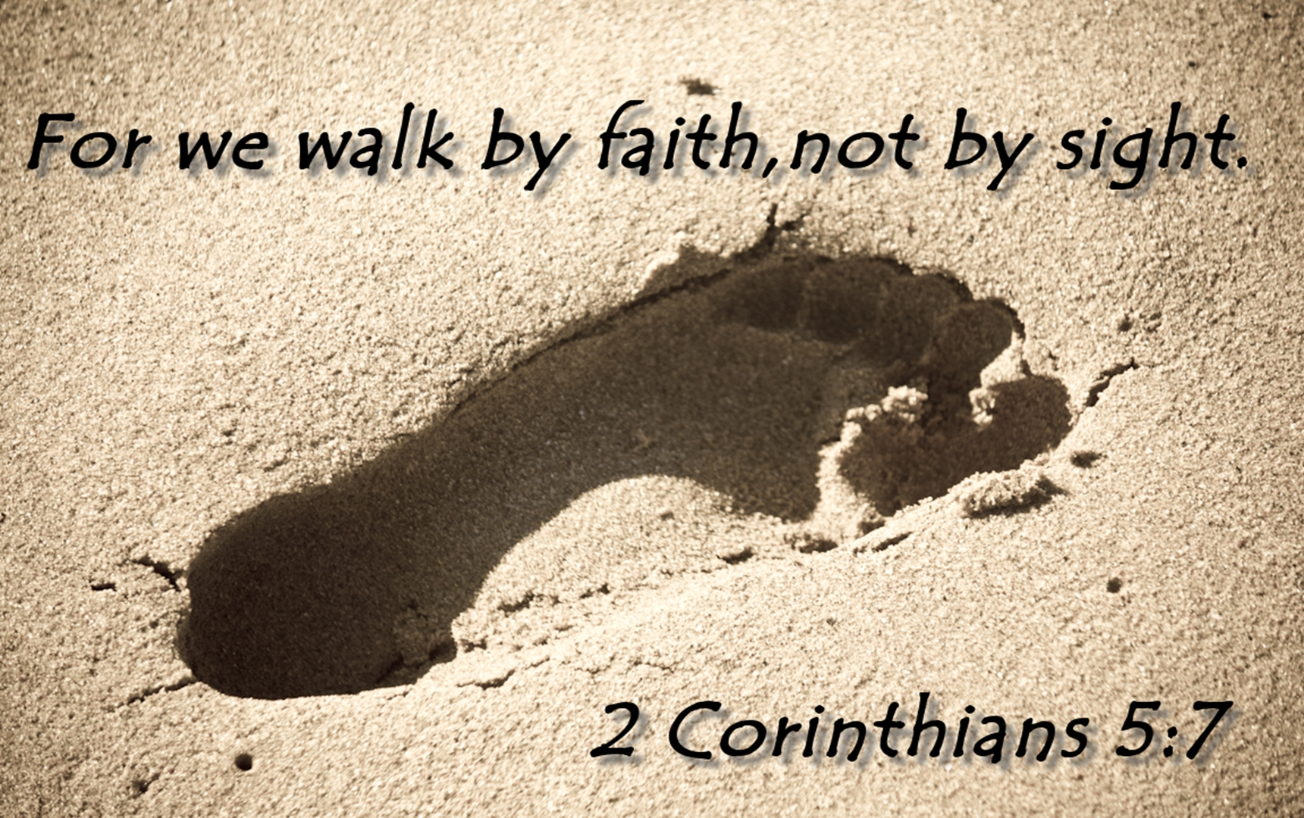
Walking By Faith and Not Sight Part 3
GENESIS 13:5-18

Slide 3
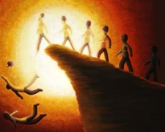
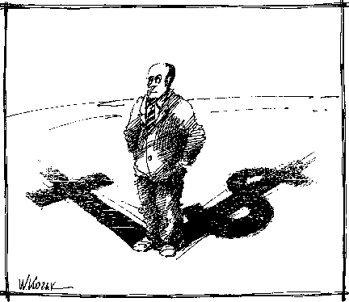

The Conflict Generated By The Carnal Christian: Verse 6-7
James 4:1-3
The danger of ruining family relationship
The Danger of Ruining Their Witness or Testimony For God.

Slide 4
2. The Consideration of the Mature Christian (verse 13:8-9)
The Mature Christian Looks for Ways To Resolve Conflict.
Abram had the right to choose first, and he deserved that right.
He was the older,
The head of the family.
He was the person to whom God had promised the land.
He was the leader, the one who had led the pilgrims to the Promised Land.

Slide 5
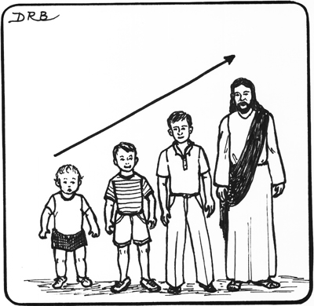

This illustrates to us what a mature Christian is:
A mature Christian is unselfish.
A mature Christian lives a sacrificial life.
A mature Christian is humble and meek.
Hebrews 10:24
Romans 12:10

Slide 6
The Carnal Christian Makes Poor Choices: Genesis 13:10-12
The Spiritual Christians Will Have God's Promises and Blessing Confirmed In Their Lives: Genesis 13:14-18
Amos 3:3
2 Corinthians 6:17-18
God's Reward to the Spiritual Christian
Spiritual Christian's Response To God's Confirmation

Slide 7
Abraham announcement as a witness for the one and True Living God :
Every time we come together to worship God, we are witnessing to the world that we serve and worship the Living God that has made heaven and earth.
We are a witness to His mercy, love and grace to mankind.
We are a witness that God longs to bring a fallen humanity back to a right standing with Him.
We are a witness to God's provision of salvation through faith in the Lord Jesus Christ.
We are a witness that the Just Lives by faith and not Sight.

