Slide 1
MARRIAGE SEMINAR
TBOLF
12th March 2016

Slide 2
Brothers, what are the 2 most important characteristics you expect in your wife?
Love x3
Care for me & children
Integrity
Truth & Honesty x2
Understanding
Submission to me x2
Be more cheerful
Understanding
Wisdom
Communicative
Spend time with me
Cook delicious NV
Spiritual, God-fearing
Submission to God
Cooperative
Think as I do
Supporter
Good listener x3
Godly
Respectful
Be my prayer partner

Slide 3
Sisters, what are the 2 most important characteristics you expect in your husband?
Godly husband who loves the Lord x2
Loves me as Christ loved the church
Spend more time with children
Listen more and speak less
Time management
Setting his priorities right
Understanding and supportive
A very prayerful man
Prioritizing God and family above all other things
Should love me unconditionally

Slide 4
Sisters, what are the 2 most important characteristics you expect in your husband?
Most thing I expect is fear of the Lord
Take decision & responsibility in all family matters
To be a spiritual leader esp Family altar
To fulfill God’s plan & purpose in action
To create an atmosphere of leader or head at home
Christ-like nature
Be organized in all things
Communication / Understanding / Patience / Gentleness / Love & care /Prayerful

Slide 5
1. Men and Women are different
2. Roles of Husbands and Wives
3. Conflicts in Marriage – part 1
Let’s start with … …
Men and Women are different

Slide 6
Men and Women are different!
Ephesians 5: 21-33
  Imitate God in everything you do
  Live a life of Love
  Give Thanks for everything
  Submit to one another
  Wives – submit & respect your husbands
  Husbands – love, make her holy, be sacrificial

Slide 7
Men and Women are different!
1 Peter 3: 1-7
  Wives …
    Accept the authority of husband,
    Live godly, pure & reverent lives,
    Have an inward God-given, unfading beauty,
    Have a gentle & quiet spirit,
    Trust God.
  Husbands …
    Honor your wives,
    Treat your wives with understanding,
    Dwell with understanding,
    Treat her well.
A
T
T
I
T
U
D
E
A
C
T
I
O
N

Slide 8
Men and Women are different!
Genesis 2:7; 15-23
Analysis:
  From the man God created, He took out something that He never replaced
  When God created the woman, He left something in the man that He didn’t put in the woman
Logical conclusion:
  What God took out of man, He never replaced; therefore, man cannot be the same as woman!
  What God left in man, He did not put in woman; therefore, woman cannot be the same as man!

Slide 9
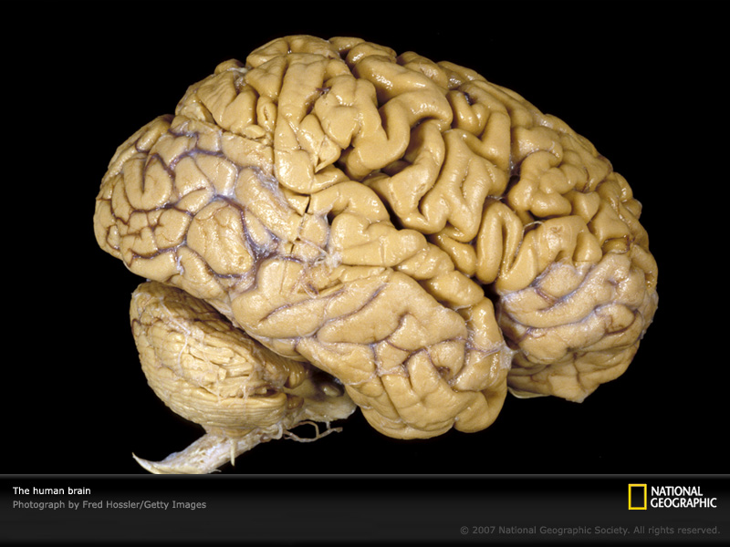
Brain Development
Paul Mobius (1903) measured the volumes of skulls of men & women … and found that:
The overall size and volume of male brain is 8% more than that of female brain!

Slide 10
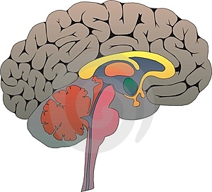
Differences in Brain Development
Female brain:
Better at complex thinking
Better multi-tasking
Increased communication
Male brain:
Greater physical activity
Better at skill-based activities
Better uni-tasking
Decreased communication

Slide 11

Man … in the Garden
Genesis 2: 15-20

Slide 12



Woman … in the Garden
Genesis 2: 21-23

Slide 13
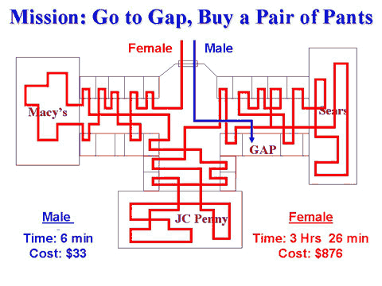
Shopping!

Slide 14


Problem-solving
Woman’s Way
Man’s Way

Slide 15
New Characteristics
Genesis 3: 1-3
Genesis 3: 6-7
Genesis 3: 12

Slide 16
Summary
1. What God took out of man, He never replaced
    Therefore, it is not in man to be a woman
What God left in man, He did not put in woman
    Therefore, it is not in woman to be a man
2. Men, before God gives you a wife,
He gives you a job
Women, before God gives you a husband,
He gives him a job

Slide 17
Summary
3. Men often deal with issues impersonally
Women deal with issues personally
4. Men are Goal oriented, Mission oriented, Performance oriented and Solution oriented.
Women are Relationship oriented, Intimacy oriented, Fellowship oriented and Communication oriented.
5. Men decide by logical planning
Women decide by feelings!

Slide 18
Summary
6. Women solve problems by
talking about them,
Men solve problems by
withdrawing into themselves
7. Women often improve on everything
Men often pass the buck
8. Men are stewards ---
- to guard, to guide, to govern;
- to direct, to protect, to correct.
And women are meant to be recipients of this stewardship!

Slide 19

Roles of Husbands and Wives

Slide 20
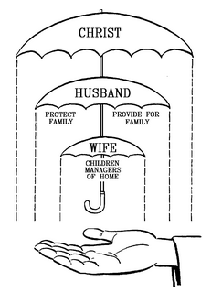
The ‘Umbrella’ to a Godly Marriage
What does the BIBLE say?
Role model for the man:
JESUS CHRIST – His authority, His servant- leadership and His love
Role model for the woman:
JESUS CHRIST – His submission to the Father and His expectation of the church
Basic Scripture References:
- Genesis 2&3; Ephesians 5:1-33; Colossians 3:18-19; 1 Peter 3:1-7

Slide 21
Role of the Husband
1 | Is the Priest in the home
2 | Is the Leader / Head / Influencer (Not Dictator) at home (not manager)
3 | Provides and protects wife (and children) from all forms of attack
4 | Considerate to the wife and Understands her needs
5 | Loves his wife and values her companionship
6 | Shows Respect to the opinion of his wife
7 | Demonstrates Support to the needs of his wife
8 | Enjoys Sexual intimacy with his wife
9 | Is a Role model to his children
10 | Teaches, trains, guides, and disciplines his children
11 | Honors his father and mother, thus setting an example to his children
12 | Mandatory income-maker for the home
13 | Good Communicator at home – transparent, no secrets
References: Genesis 2, 3; Eph 5: 21-24, 25-33; Col 3: 18-19; 1 Tim 3:5; 1 Tim 5:8; 1 Corin 11:3; 1 Corin 7:2-5; 1 Pet 3:7

Slide 22
1 | Submits to her own husband
2 | Is Supportive of her husband – a true and godly Helper
3 | Respects her husband
4 | Encourager to her husband
5 | Promotes home environment
6 | Manager of the home (not Head)
7 | Loves and Cares for her children
8 | Is a role model to her children
9 | Enjoys sexual intimacy with her husband
10 | Supplementary income-maker
11 | Loves her husband, and chooses to be a life-long companion
12 | Honors her father and mother, thus setting an example to her children
13 | Good Communicator at home – transparent, no secrets
14 | Is the ideal ‘Proverbs 31’ Home-maker
Role of the Wife
References: Genesis 2, 3; Prov 31; Prov 2:16-17; Mal 2:14; Eph 5: 22-24, 33; Col 3: 18-19; 1 Tim 3:11; 1 Tim 5:14; Tit 2:4-5; 1 Corin 7:2-5; 1 Pet 3:1

Slide 23
10 Commandments for Husbands
Thou shalt not take thy wife for granted, but will honour and respect her as thy equal. (1 Pet 3:7)
Thy highest allegiance, except God, shall be to thy wife, not thy relatives or friends. (Gen 2:24)
Thou shalt frequently tell thy wife how important & valuable she is to thee. (Phil 2:3; Prov 31:10-11)
Thou shalt hold thy wife's love by the same means that thou won it. (Sos 5:10-16)
Thou shalt actively establish family discipline with thy wife's help. (Eph 6:4)
Remember to do all the little things for thy wife when you say you will. (Mt 5:37)
Keep thine eyes on thy own wife, not thy neighbors. (Prov 5:15-20; Job 31:1; Jer 5:8)
Thou shalt make every effort to see things from thy wife's point of view. (Gen 21:12)
Thou shalt not be stingy with thy wife when it comes to money. (Esther 5:3)
Thou shalt love thy wife, thine own wife, all the days of thy life (Eph 5:25,33; Col 3:19)

Slide 24
10 Commandments for Wives
Expect not thy husband to give thee as many luxuries as thy father hath given thee after many years of hard labor. (Phil 4:11; Amos 4:1)
Thou shalt work hard to build thy house with the husband that you have, not fantasizing about "the one that could have been". (Prov 14:1)
Thou shalt not nag. (Prov 27:15; 21:19)
Thou shalt coddle thy husband and be a warm wife. (1 Cor 7:3-5)
Remember that the frank approval of thy husband is more to thee than the side glances of many strangers. (Ezek 16:32; 2 Pet 2:14)
Thou shalt not yell at thy husband but will be a gentle and quiet spirit. (1 Pet 3:1-4)
Permit no one to assure thee that thou art having a hard time of it. (1 Pet 5:9)
Thou shall not fail to dress up for thy husband with an eye to please him, as thou didst before marriage. (Sos 4:9-11)
Thou shalt submit to thy husband from thy heart and allow him to be head of the household. (Col 3:18; 1 Pet 3:6; Eph 5:22,33)
Thou shalt assure thy husband and others that he is the greatest man alive. (Sos 5:9-16)

Slide 25

Conflicts in Marriage
(part 1)

Slide 26
“Marriages are made in heaven, but so is thunder and lightning!”
All marriages have their ups and downs simply because:
  We are flesh and blood
  We do not have full and complete knowledge
  We are individuals with own likes and dislikes
  We all carry our historical baggage into our marriages

Slide 27

Genesis of Conflicts in the Home
Differing Objectives
Differing Paths
Hurtful Behaviour
Communication
Working Together
Objectives Achieved

Slide 28
Common Causes of Conflicts in Marriage
Differing objectives in marriage
  Reflect God’s image – Genesis 1:26-27
  Reproduce – Genesis 1:28; Malachi 2:15
  Reign – Genesis 1:28
Improper communication – Ephesians 4:26, 29; Proverbs 15:1; Proverbs 18:6-7
Financial disagreements – Deuteronomy 8:18; Deuteronomy 15:6; Deuteronomy 28:12; Hebrews 13:5; Philippians 4:12; Luke 12:15

Slide 29
Common Causes of Conflicts in Marriage
Differing viewpoints – Genesis 21:9-14
Addiction – to work, to alcohol/ drugs, to social media, to pornography
Dominating spouse – 1 Corinthians 11:3
Sexual dissatisfaction & Adultery – 1 Corinthians 7:2-5; Hebrews 13:4; Proverbs 5:18-20
Delayed blessing including Barrenness – Hebrews 6:11-12

Slide 30
DANGER SIGNS
Signs are to warn us so as to adjust our actions to avoid trouble or accidents.
    Poor or No communication
    Feelings of insecurity
    Lack of confidence in the spouse
    Outside influence and interference
    An unforgiving attitude
    Individual planning
    Taking each other for granted

Slide 31
CONFLICT RESOLUTION
Turn to God first and foremost
  PRAY – PUSH & PULL
Know, accept & adjust to your differences
Defeat selfishness
Pursue the interests of your spouse
Learn to Forgive
Communicate lovingly, not confrontationally
Return blessings for insults
Seek Godly counsel
Never mention Divorce or Separation

Slide 32

Brothers & Sisters …
… Have a Blessed Home!

