Slide 1
The Bread of Life Fellowship Oman
-
Website Demonstration

Slide 2
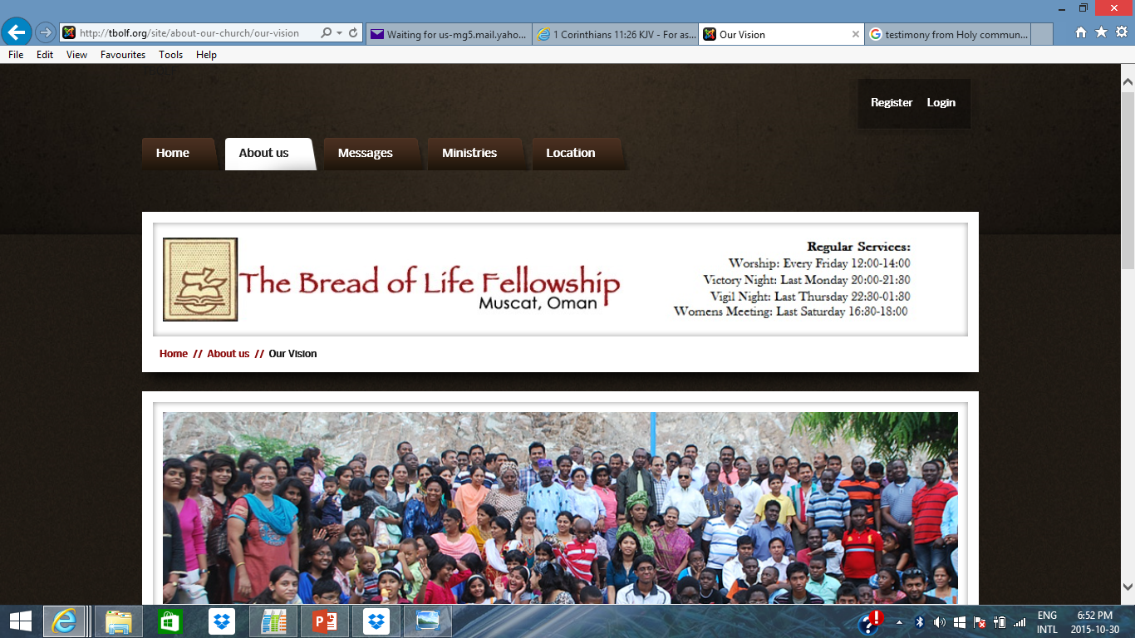
The Bread of Life Fellowship Oman - Website
  www.tbolf.org

Slide 3
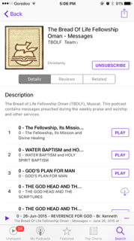
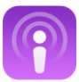
www.tbolf.org - Podcasts
Download Podcasts Apps
Search and Subscribe to “The Bread of Life Fellowship Oman – Messages”
Listen to message online or download and listen offline

Slide 4
Sanctification

Slide 5
Sanctification
The Bible teaches that without holiness, no man can see the Lord. We believe in the doctrine of Sanctification as a definite yet progressive work of grace, commencing at the time of regeneration and continuing until the consummation of salvation (Hebrews 12:14, 1 Thessalonians 5:23, 2 Peter 3:18, Philippians 3:12-14, 1 Corinthians 1:30)

Slide 6
What is Sanctification? It is the gracious work of the Holy Spirit whereby a believer is free from sin and attain to holiness of heart and life. Heb 12:14, Eph. 5:25-27, 1 Thess. 5:23
Similar words with same meaning used in the Bible are:
Holiness- Luke 1:75; Eph. 4:24; I Thess. 4:7; Heb. 12:10;
1 Peter 1: 15,16.
A pure heart- Psalm 24:4; 73:1; Matthew 5:8.
Circumcision of heart- Deut. 30:6; Col. 2:11; Romans
2:29.
Perfection- Genesis 17:1; Matthew 5: 48; 2 Cor. 13:9; 1
John 4:17,18.

Slide 7
Two folds nature of sin
Outward Sins, Actual committed sins which get forgiven
at Conversion John 5:14, John 8:11
Inward Sin, Indwelling sin, inbred sin or inherited wickedness which gets purged, cleansed and the heart is purified at Sanctification Romans 6:6, Isaiah 6:7,
  Titus 2:14 Who gave himself for us, that he might redeem us from all iniquity, and purify unto himself a peculiar people, zealous of good works.
  A Believer cannot enjoy the beauty of being a Christian until
  He or she is sanctified 2 Cor. 7:1

Slide 8
Sanctification
Distinctions Between Justification (Salvation) and Sanctification (Progressive Experience)
Compare John 1:12; vs 17:14-19, Eph. 2:8, 9 vs 5:25-27, and 1 Thess. 1 :2-9 vs 5:22-24.
Justification gives the right to heaven while Sanctification gives the fitness for heaven.
Salvation is the Passport to identify you as candidate for heavenly. While Sanctification is your Entry Visa to heaven.
  Hence:
  You must get your Passport by being Born Again
  You must secure your Entry Visa by being Holy and Sanctified
  Get ready for your ticket / flight to heaven (rapture / death)

Slide 9
Why the need to emphasize what we believe as a Church about Sanctification
This Church is combination of people from different backgrounds and more so we are constantly exposed to various teachings on the social media (TV, mobile, etc)
  1 Timothy 4:1 Now the Spirit speaketh expressly, that in the latter times some shall depart from the faith, giving heed to seducing spirits, and doctrines of devils;
Some Churches believe the so call “ONCE SAVED ALWAYS SAVED” concept:
  It does not matter how you live your life after salvation
  Sin is no longer sin for you since you are already saved
  This is a concept from the pit of hell - LIE OF THE DEVIL

Slide 10
Sanctification
The Truth is, It is possible for a believer (careless) to lose his or her salvation and go to hell
Jesus Words About This Truth
  Luke 9:62 , Matthew 7:21-23, Matthew 24:13, Revelation 2: 2-5
Examples of people that lost their salvation
  Matthew 27:3-5, Philemon 1:24, 2 Timothy 4:10
Heaven is not for Backsliders, Careless and Reckless
Believers - Revelation 21:27
Warning for All Born Again Christians (Not Unbelievers)
  Philippians 2:12, Hebrews 10:26,
  2 Timothy 2:19 Nevertheless the foundation of God standeth sure, having this seal, The Lord knoweth them that are his. And, let every one that nameth the name of Christ (believers) depart from iniquity.

Slide 11
Sanctification
Strategy for Staying Holy, Sanctified and Be fully Ready for Heaven
Ensure you are growing in the Knowledge of God
The closer you are to God the more sanctified you
become and the farther you will be from the devil and
his tricks.
2 Peter 1:3-11 (NLT)
3 By his divine power, God has given us everything we need for living a godly life (Holy Life). We have received all of this by coming to know him, the one who called us to himself by means of his marvelous glory and excellence.
8 The more you grow like this, the more productive and useful you will be in your knowledge of our Lord Jesus Christ. 9 But those who fail to develop in this way are shortsighted or blind, forgetting that they have been cleansed from their old sins.
10 So, dear brothers and sisters, work hard to prove that you really are among those God has called and chosen. Do these things, and you will never fall away. 11 Then God will give you a grand entrance into the eternal Kingdom of our Lord and Savior Jesus Christ.

Slide 12
Holy Communion

Slide 13
The Holy Communion
The Lord‘s Supper, consisting of the elements bread and fruit of the vine, is the symbol expressing our sharing the divine nature of our Lord Jesus Christ; a memorial of His suffering and death; and a prophesy of His second coming; and is enjoined on all believers “till He comes!”(2 Peter 1:4, 1 Corinthians 11:26)

Slide 14
Christ Instituted and Commanded the Practice of Holy Communion
Luke 22:14-20
  14 -18: Christ partook of the last Old Testament Passover
  19-20: Christ Instituted The New Testament Passover which we refer to as Holy Communion, The Lord’s Supper and The Lord’s Table
This is one of the direct doctrinal instruction given by
Jesus to his beloved Church
Any believer not partaking in it is living in disobedience and in fact not part of the Church.
However, there is need to understand the purpose and conditions attached to partaking in Holy Communion.

Slide 15
The Meaning, Purpose and Essence of Holy Communion - 1 Cor. 11:23-34
It is a special and unique meal with the Lord which serve as a remembrance of the sacrificial death of Christ and the impact on mankind (24-25, 17-22, 33-34)
It is an opportunity to ensure adequate preparation for Christ second coming through continual re-examination of our commitment to Jesus. (26,28 John 6:54, Rev. 19:9, Matt. 26:29, 2 Cor. 13:5)
  Qualification for partaking in the Meal:
    Born Again and Sanctified (Heb. 10:26, Gal. 5:19-21, Acts 19:18)
    Baptized by Immersion in Water
    Children are not permitted in TBOLF

Slide 16
The Meaning, Purpose and Essence of Holy Communion - 1 Cor. 11:23-34
A Demonstration of our Oneness with Christ and A unifying platform for all believers (33,11-24, John 6:56, Rom. 8:17, Luke 22:19-20)
  Help us to showcase our true identity in Christ.
  Opportunity for fellowship and unity among brethren
  Where? Church and at Home
  What? Any Bread and Wine (zero % alcohol)
  How? Sequence - 1st Bread and 2nd Wine

Slide 17
The Meaning, Purpose and Essence of Holy Communion - 1 Cor. 11:23-34
A divine package by God for His Children to enjoy the fullness of Christ (2 Peter 1:4, Ps. 105:36-38, Ex. 12:35-36, Isaiah 53:5, Prov. 13:22, John 6:54-58)
  Holy Communion grant you direct access to everything that is obtainable in Jesus Christ
    Freedom, Favour, Prosperity
    Divine protection, Victory, Extra Ordinary Grace
    Divine Healing and Sound Health
    Eternal Life
    And every other thing your desire and it is traceable to Jesus Christ.

Slide 18
Warning About taking the Meal Unworthily and the Consequence - 1 Cor. 11:27-28
Be warned
Never take part if you are not qualified
  If you have any doubt – seek for counsel and clarification than taking it unworthily
  Hebrews 10:31 It is a fearful thing to fall into the hands of the living God.
Consequences
Weakness, Sickness, Death and Hell.
Examples
Peter took part worthily and got fully restored
Judas Iscariot took part unworthily and got destroyed.

