Slide 1
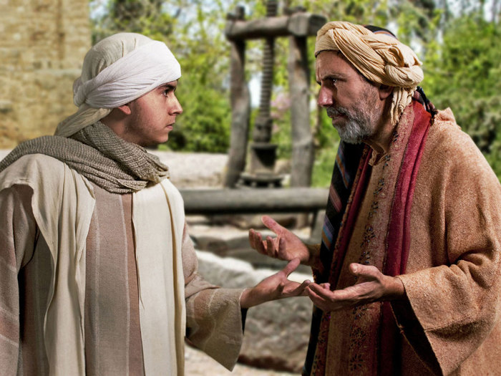

Slide 2
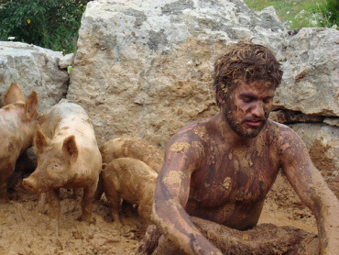
HOPE FOR HURTING PARENTS LUKE 15:11-24
STAGE 1: THE REBELLION OF THE SON.
LET THEM GO
LET THEM MAKE THEIR OWN MISTAKES
LET THEM REAP THE CONSEQUENCES OF THEIR OWN CHOICES

Slide 3
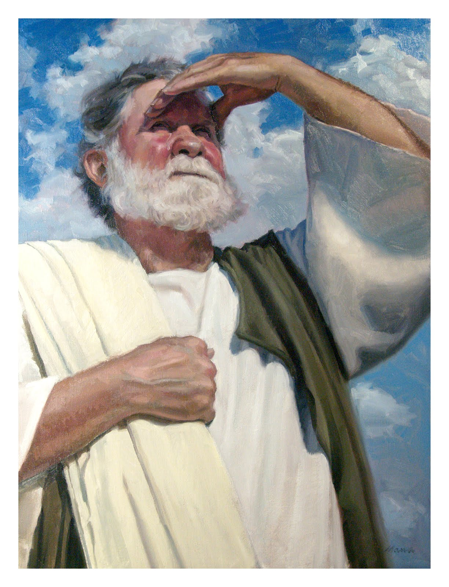
STAGE 2: RE-EVALUATION AND REGRET
YOU PRAY
COMMIT
WAIT

Slide 4
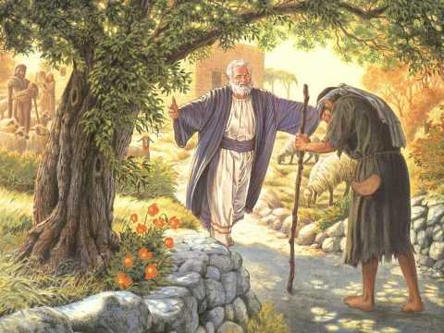
STAGE III. THE RETURN
LOVE THEM FAITHFULLY
ACCEPT THEM UNCONDITIONALLY
FORGIVE THEM COMPLETELY
Bring forth a robe
Put a ring on his finger
Restored to a full relation

