Slide 1
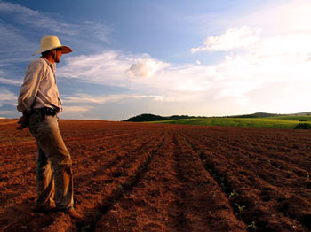
HOW TO DEVELOP PATIENCE
Grow Up Don't Give Up- Part 15
James 5:7-12

Slide 2
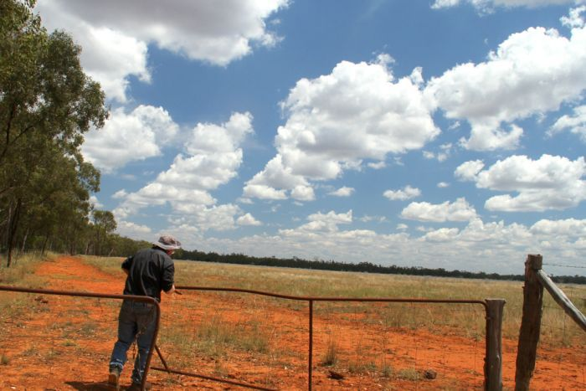
Three different illustrations to teach us
When to be patient
Why be patient
How to be patient

Slide 3
I. WHEN SHOULD I BE PATIENT?
When circumstances are uncontrollable
  Verse 7 "Be patient then brothers, until the Lord's coming. See how the farmer waits for the land to yield its valuable crop and how patient he is ..."
When people are unchangeable
  Verse 10 "As an example of patience in the face of suffering, take the prophets who spoke in the name of the Lord.“
When problems are unexplainable
  Verse 11, "You have heard of Job's perseverance

Slide 4
II. WHY SHOULD I BE PATIENT?
Because God is in control
  Verse 8 "Be patient and stand firm, because the Lord's coming is near."
God rewards patience.
  Verse 11a "As you know, we consider blessed those who have persevered."
  Matthew 5:13-14

Slide 5
Because God is working things out
  Verse11b "You have heard of Job's perseverance, and have seen what the Lord finally brought about. The Lord is full of compassion and mercy."
  Philippians 2:13
  Romans 8:28

Slide 6
III. WHAT AM I SUPPOSED TO BE DOING WHILE I'M WAITING ON GOD?
Wait expectantly
Psalm 130:5 (LB) "... I wait expectantly, trusting God to help, for He has promised."
Isaiah 49:23

Slide 7
Wait quietly
  James 5:9, 12
  Lamentations 3:26 "It is good to wait quietly for the salvation of the Lord
  Hab. 2:3
Wait confidently
  Micah 7:7
  Ps. 37:7 "Be still before the Lord and wait patiently for Him to act."

