Slide 1
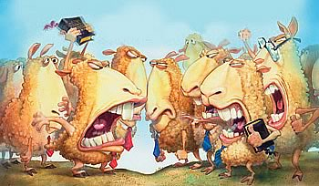
CONQUERING CONFLICT IN THE CHURCH
Growing Up Rather Than Giving Up - Part 9
James 4:1-10

Slide 2
I. CAUSES OF CONFLICT: -James 4:1
The desire to have things v2
The desire to feel good v3
The desire to be number one Prov 13:10
Unfulfilled desires causes conflict v2-3
We don’t pray v2
We pray with the wrong motives v3a
We have ruptured our relationship with God v4

Slide 3
II. THE CURE FOR CONFLICTS:
GOD'S GRACE James 4:6&10
      Romans 12:3
      1 Peter 5:5
GIVE IN TO GOD -James 4:7
      Colossians 3:15
RESIST SATAN
  We need to resist the devil by being wise
      2 Cor. 2:11

Slide 4
4. DRAW CLOSER TO GOD -James 4:8
Clean up your life
      Hebrews 10:22
Have a clean conscience
Have a full confidence with God
Have a sincere heart
      Psalm 119:9

Slide 5
5. BE SORROWFUL FOR THE CONFLICT - James 4:9
6. DON'T BE CRITICAL OR JUDGMENTAL OF OTHERS
        James 4:11-12
    Remember who the others are
    Remember who God is
    Remember WHO YOU ARE

Slide 6
6. BE WILLING TO ASK FORGIVENESS
Philippians 2:3-5 "Do nothing out of selfish ambition or vain conceit, [Why? because pride causes arguments] but in humility consider others better than yourselves. Each of you should look not only to your own interest but also the interest of others."

