Slide 1
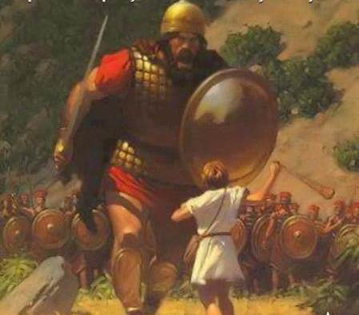
If God is for you,
Who can be against you.

Slide 2
Four ways that God has revealed that He is "for" us
THE HOLY SPIRIT PRAYS FOR US
(v. 26) In the same way, the Spirit helps us in our weakness. We do not know what we ought to pray for, but the Spirit himself intercedes for us with groans that words cannot express.

Slide 3
2. GOD ALWAYS GIVES US THE BEST –
(V28) And we know that God causes all things to work together for good to those who love God, to those who are called according to His purpose. (NASV)

Slide 4
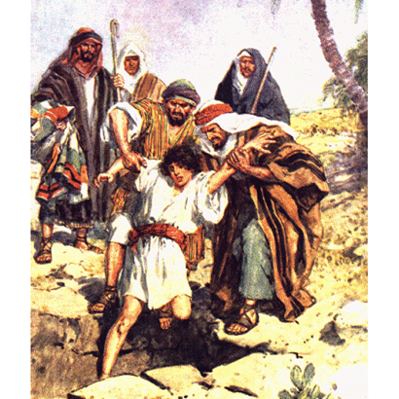
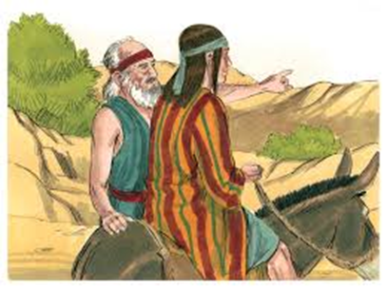
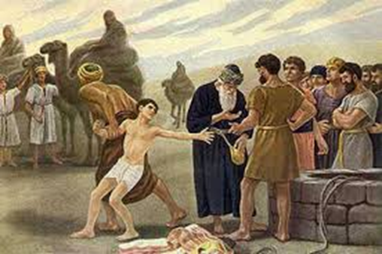
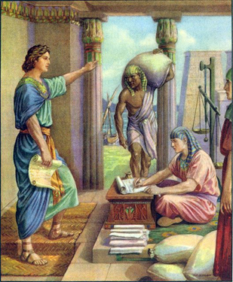
Joseph

Slide 5
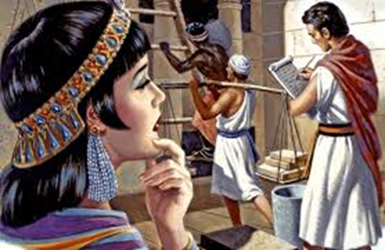
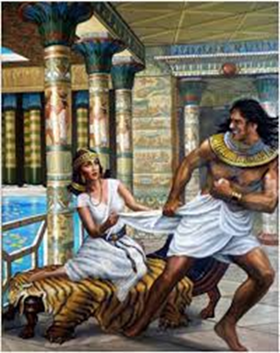
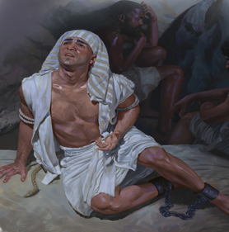
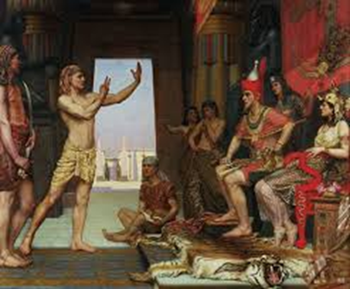


Slide 6
Deuteronomy 23:5 “However, the LORD your God...turned the curse into a blessing for you, because the Lord your God loves you.
Nehemiah 13:2 “Our God, however, turned the curse into a blessing.
3. HE GIVES US A CLEAN SLATE
(V30) And having chosen us, he called us to come to Him; and when we came, He declared us "not guilty," filled us with Christ's goodness, gave us right standing with Himself, and promised us His glory

Slide 7
Sin :
Anger, Impurity, Greed, Stealing
Malice, Arrogance, disobedience
Fits of rage, Lies, Lust, Envy
Foolish talk /Coarse joking,
Cheating, Idol worship, Slander, swindling, Drunkenness, Pride Dishonoring the body

Slide 8
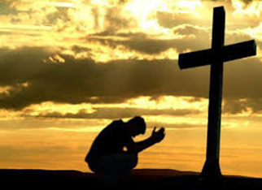
1 John 1:9 “If we confess our sins, He is faithful and just and will forgive us our sins and purify us from all unrighteousness.
Rom 8:31 B “If God is for us, who can be against us

Slide 9
4. HE GIVES US WHATEVER WE NEED v 32
We didn't know that we needed salvation,
We didn't know that sin would destroy our lives,
We didn't know that peace of mind is more valuable than money in the bank,
We didn't know that we would need spiritual power to make it through life from day to day,

Slide 10
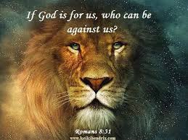
Philippians 4:19 “And my God will meet all your needs according to his glorious riches in Christ Jesus.

