Slide 1

PART 2

Slide 2
Judges 7: 1- 23
James 4:13-17
Luke 5:4-8
Matt. 16:21-23
2 Sam. 17
Num 13-14

Slide 3
LET US SEE HOW GOD’S PLAN WORK’S
God Always Has A Different Plan
God’s always confirms His Plan
He speaks through His Word, Rom. 10:17.
He speaks through the Spirit, Acts 13:2; 16:6-8.
He speaks through other believers, Acts 9:17-18.
He even speaks through the circumstances of life, Gen. 24:12-16.

Slide 4
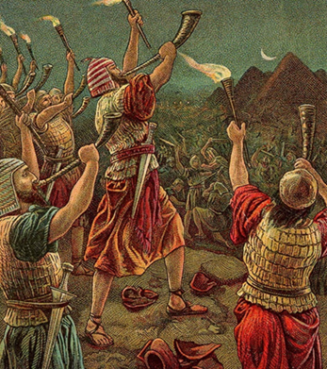
God’s Plan Is always clear V.15-23
What is required to fulfill God’s plan
Total Surrender
Rom. 8:28
Jer. 29:11
Total Obedience
1 Sam. 15:22

Slide 5
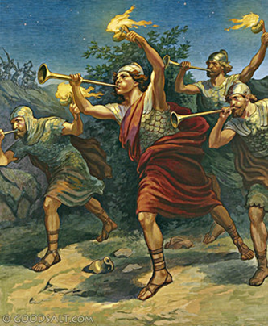
GREAT FAITH
It took great faith for :
Those 300 men to go out against 135 thousands men
Them to take no weapons
Them to blow their trumpets
Them to break those clay jars and shine those lights

Slide 6
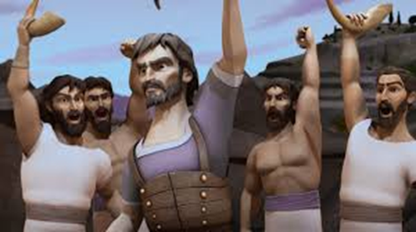
THE RESULT OF OUR OBEDIENCE TO GOD’S PLAN
Your Enemies Are Defeated V. 21-22
The glory and honor will belong to God V. 2, 15-23
1 Cor. 10:31
Matt. 5:16

Slide 7
John 14:6 Jesus answered, "I am the way and the truth and the life. No one comes to the Father except through me.
Acts 4:12 Salvation is found in no one else, for there is no other name under heaven given to men by which we must be saved."

